Slide 1
Web Design and Programming Lab-I
Outcome Based Education System
Dr. Abu Sayed Md. Mostafizur Rahaman
Professor
Anup Majumder
Assistant Professor
Bulbul Ahammad
Assistant Professor
Subarna Saha
Class Roll: 349
Exam Roll: 202165
Trisha Sarkar
Class Roll: 359
Exam Roll: 202171
Rubayed All Islam
Class Roll: 370
Exam Roll: 202182
Department of Computer Science and Engineering
Jahangirnagar University, Savar,
Dhaka-1342, Bangladesh

Slide 2
Contents
Features of OBE System
Login Registration System
Teacher Dashboard
Department Admin Dashboard
Exam Control Office Dashboard

Slide 3
Features of the Web Application
Login and Registration System
Teacher Dashboard
View Academic Calendar
Show the List of Assigned Courses
Manage Course Files
Manage Marks Submission
Department Admin Dashboard
Upload Academic Calendar
Approve Teacher Account
Assign Course Teacher
Create Exam
Same functionalities of Teacher
Exam Control Office Dashboard
Provides a User Interface for Submit Marks

Slide 4
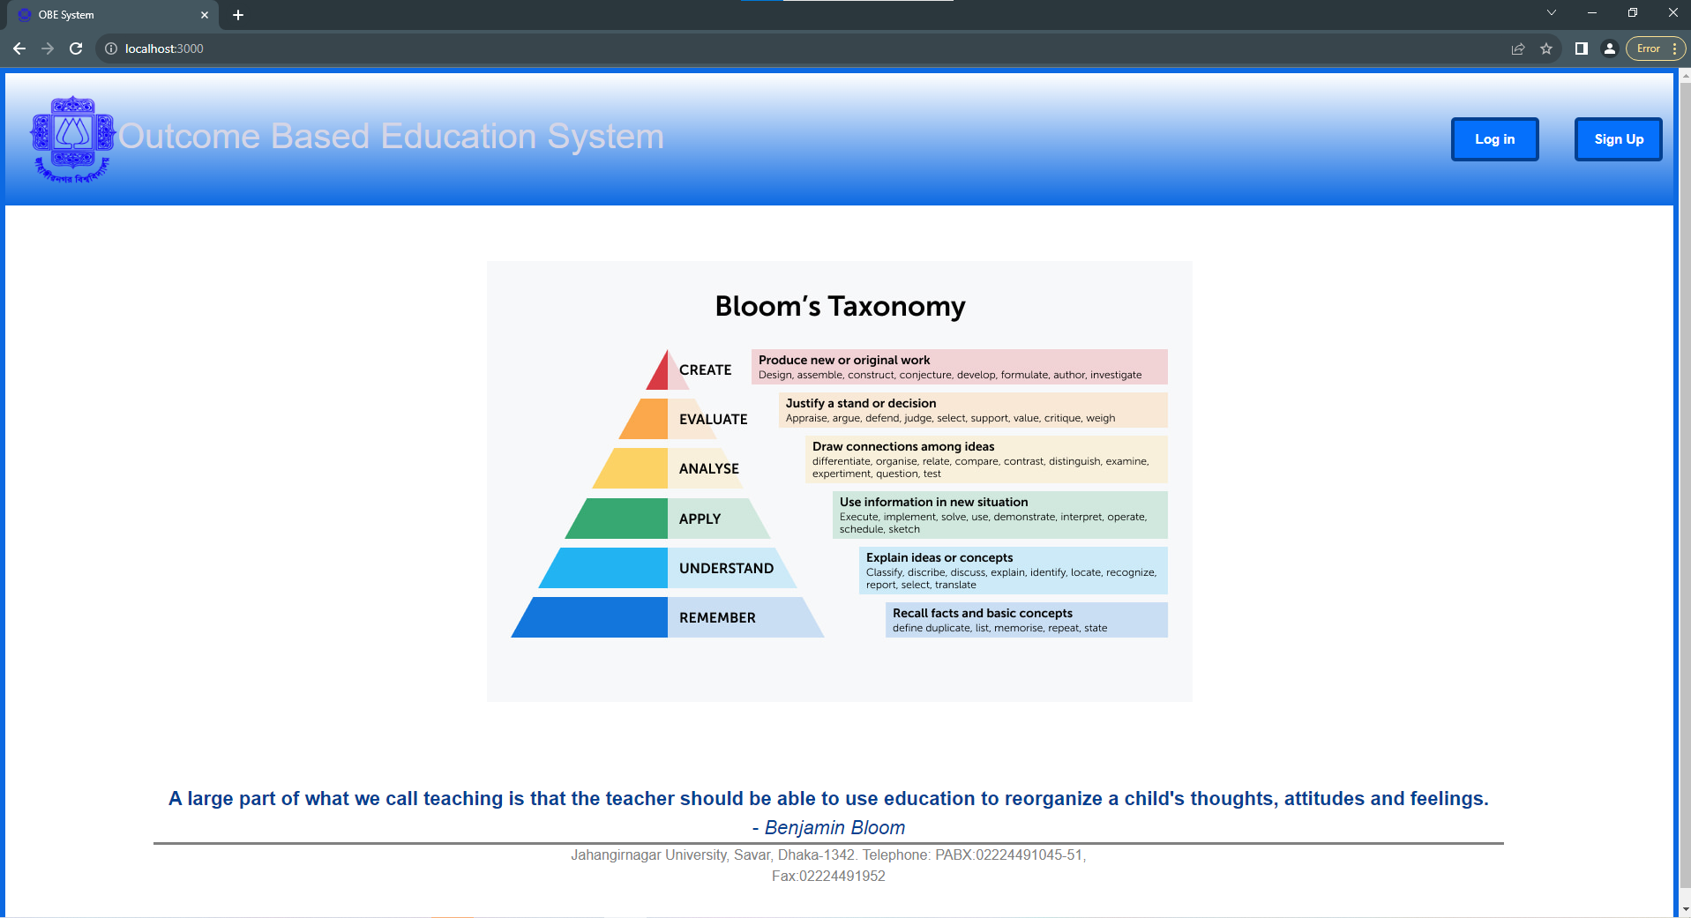
Home Page

Slide 5
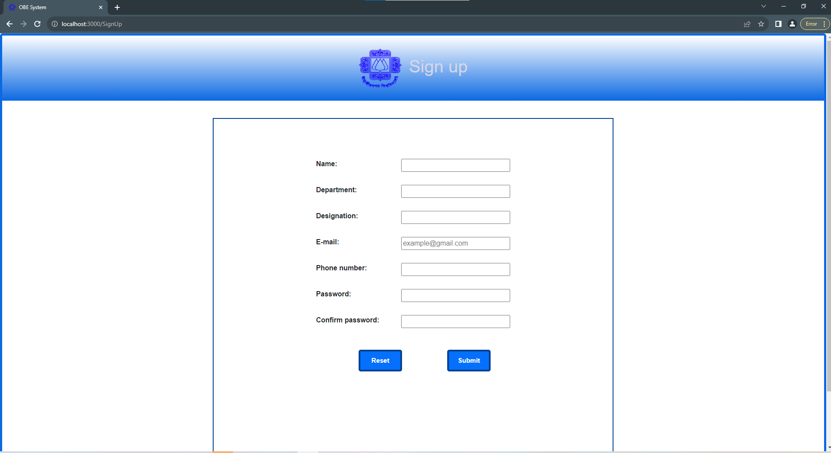
Registration as an User

Slide 6
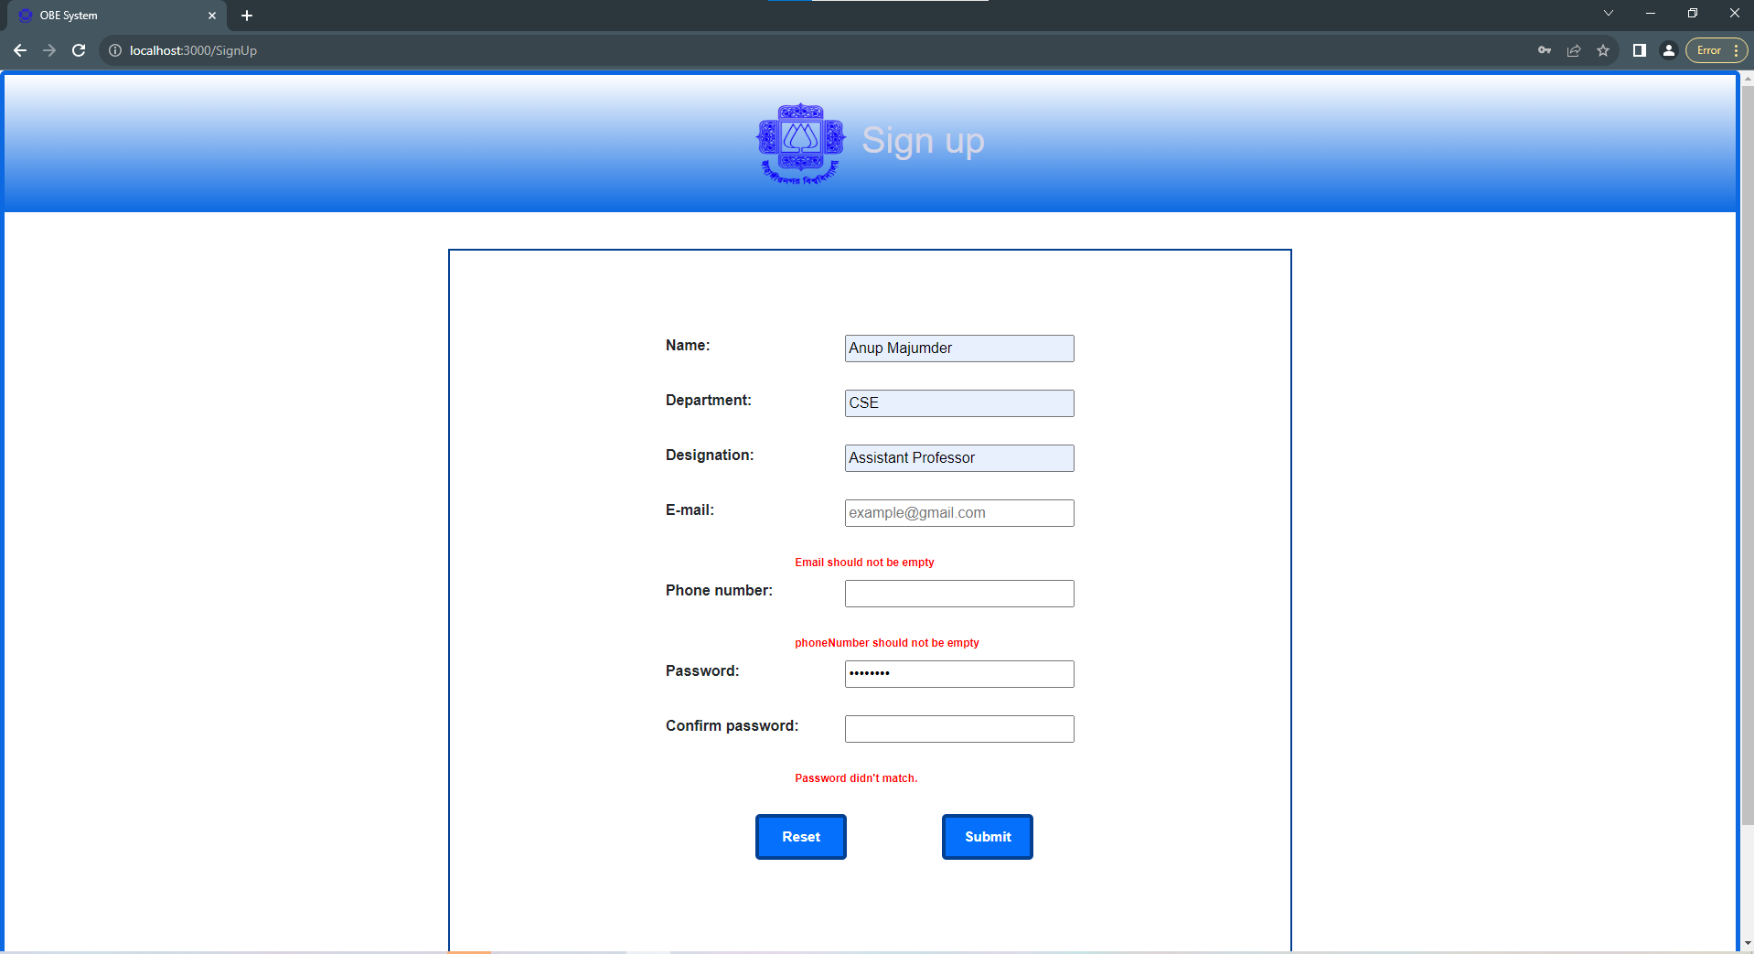
Case of Missing information

Slide 7
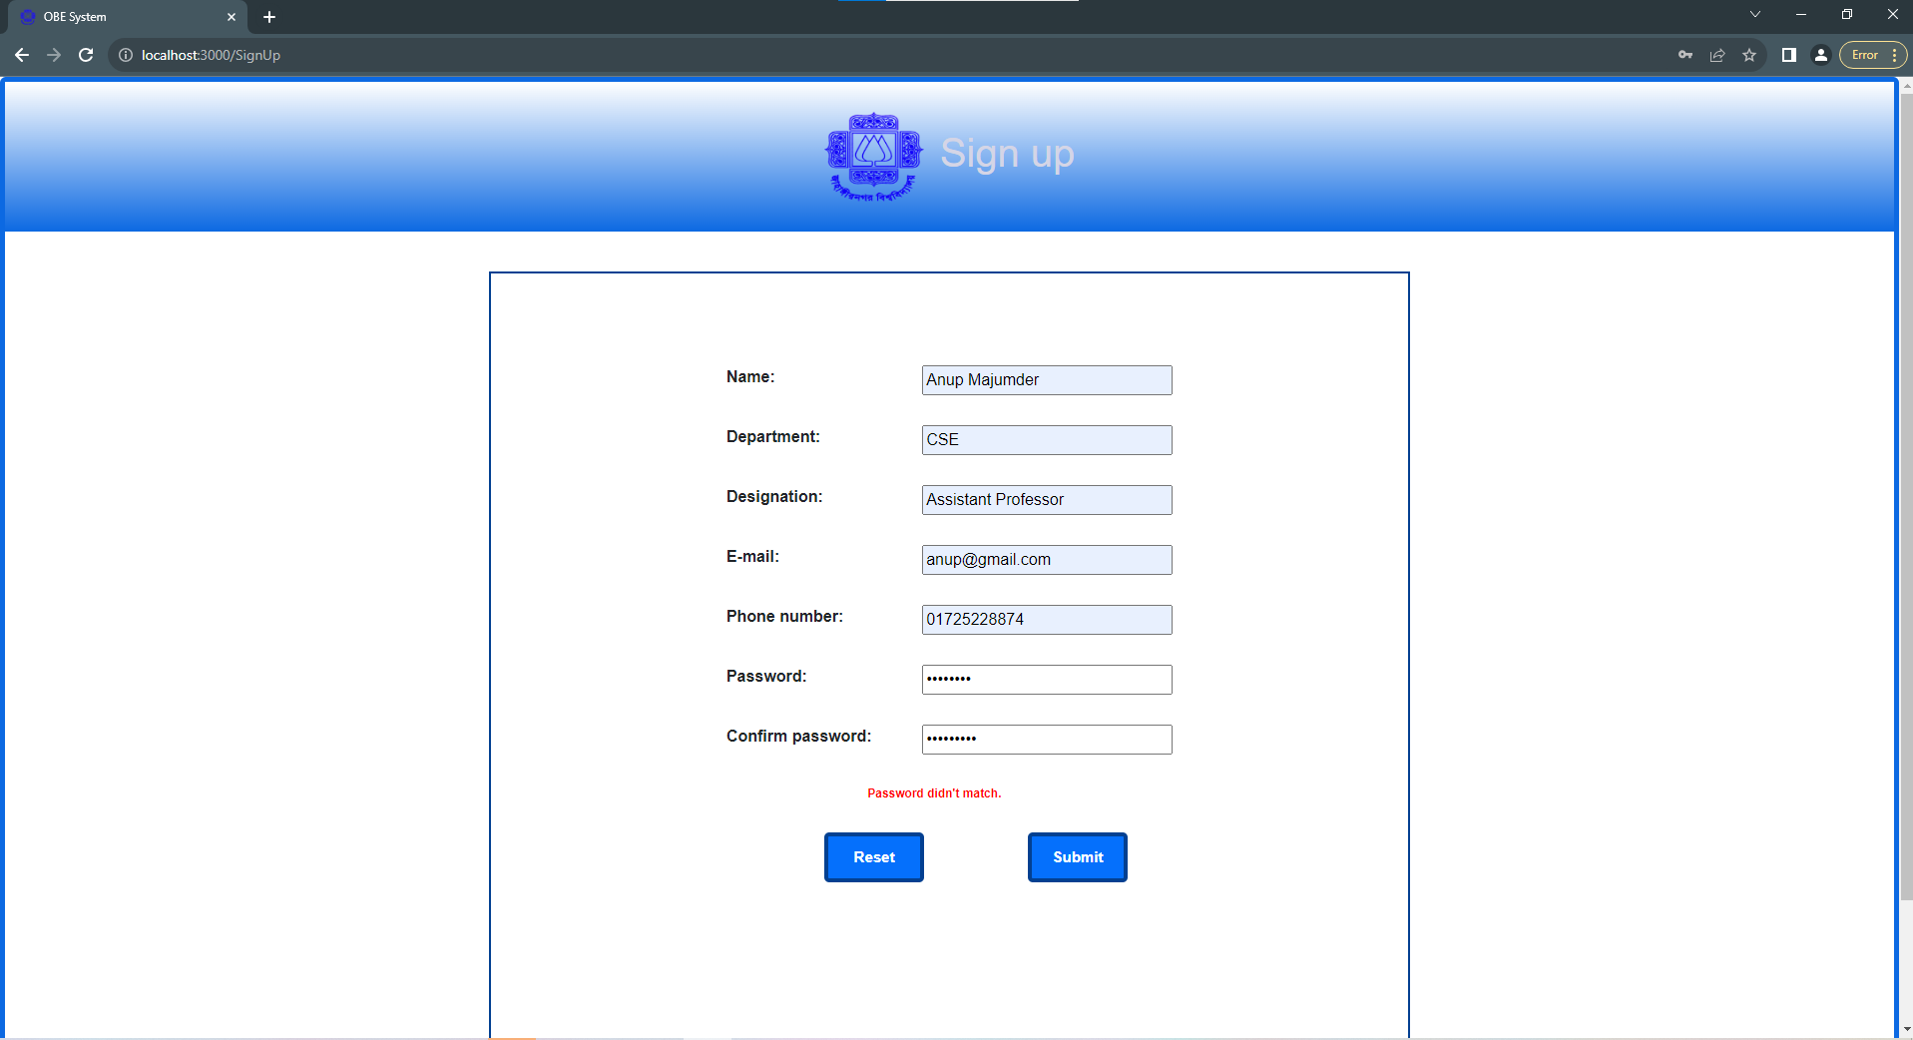
Case of Mismatch of Password and Confirmed Password

Slide 8
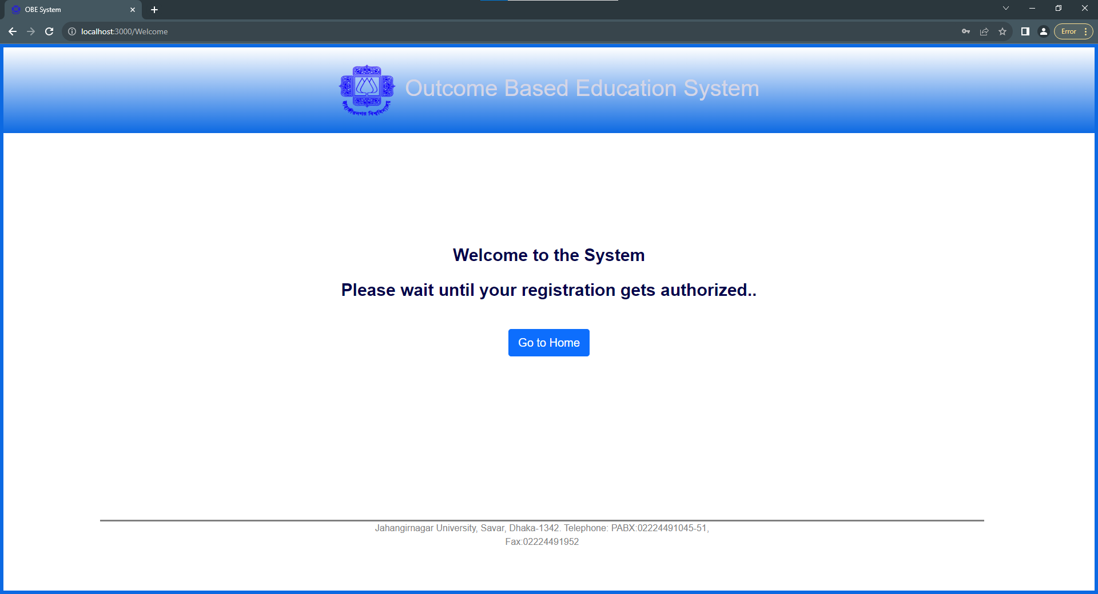
Welcome Page

Slide 9
Teacher Part

Slide 10
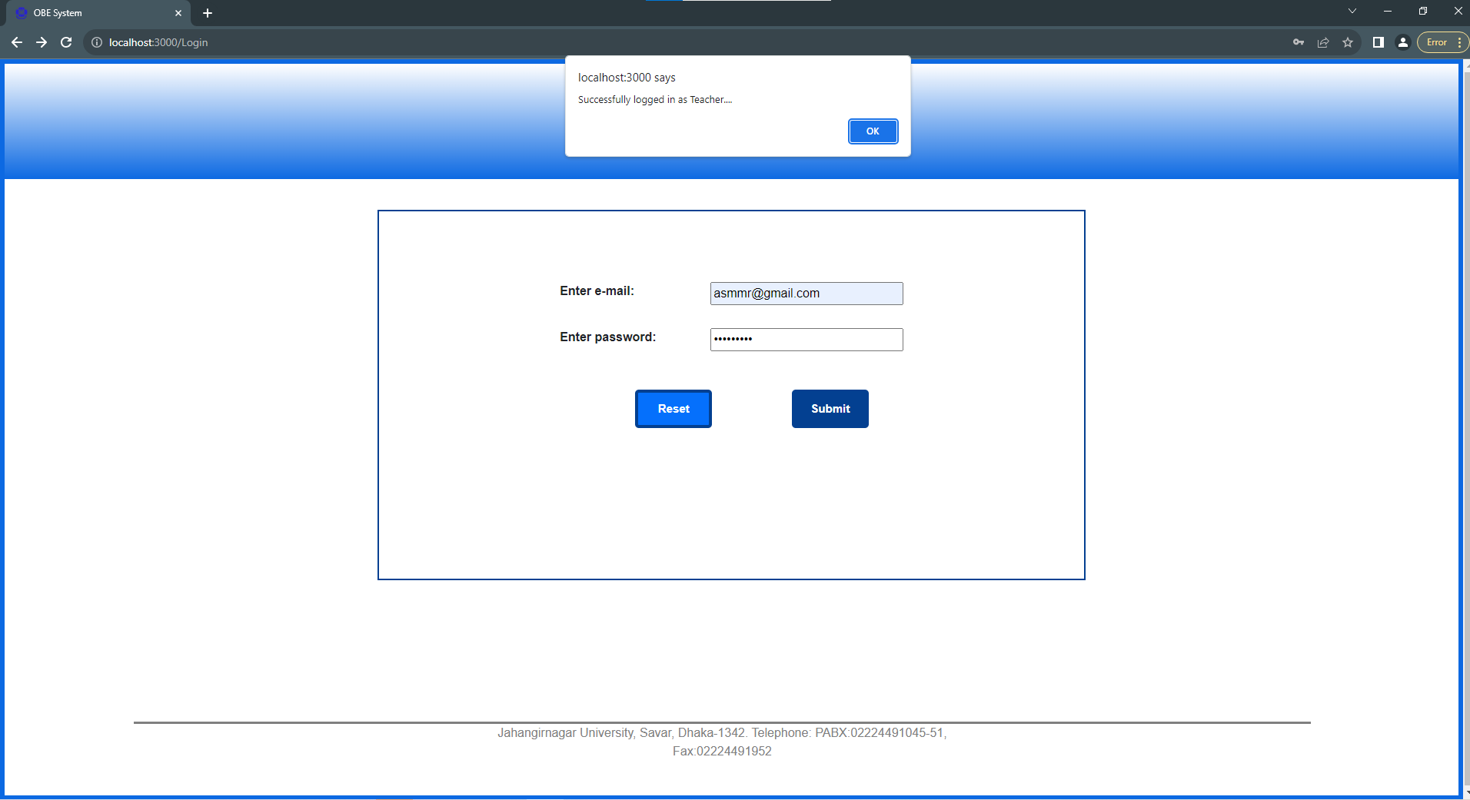
Log in page

Slide 11
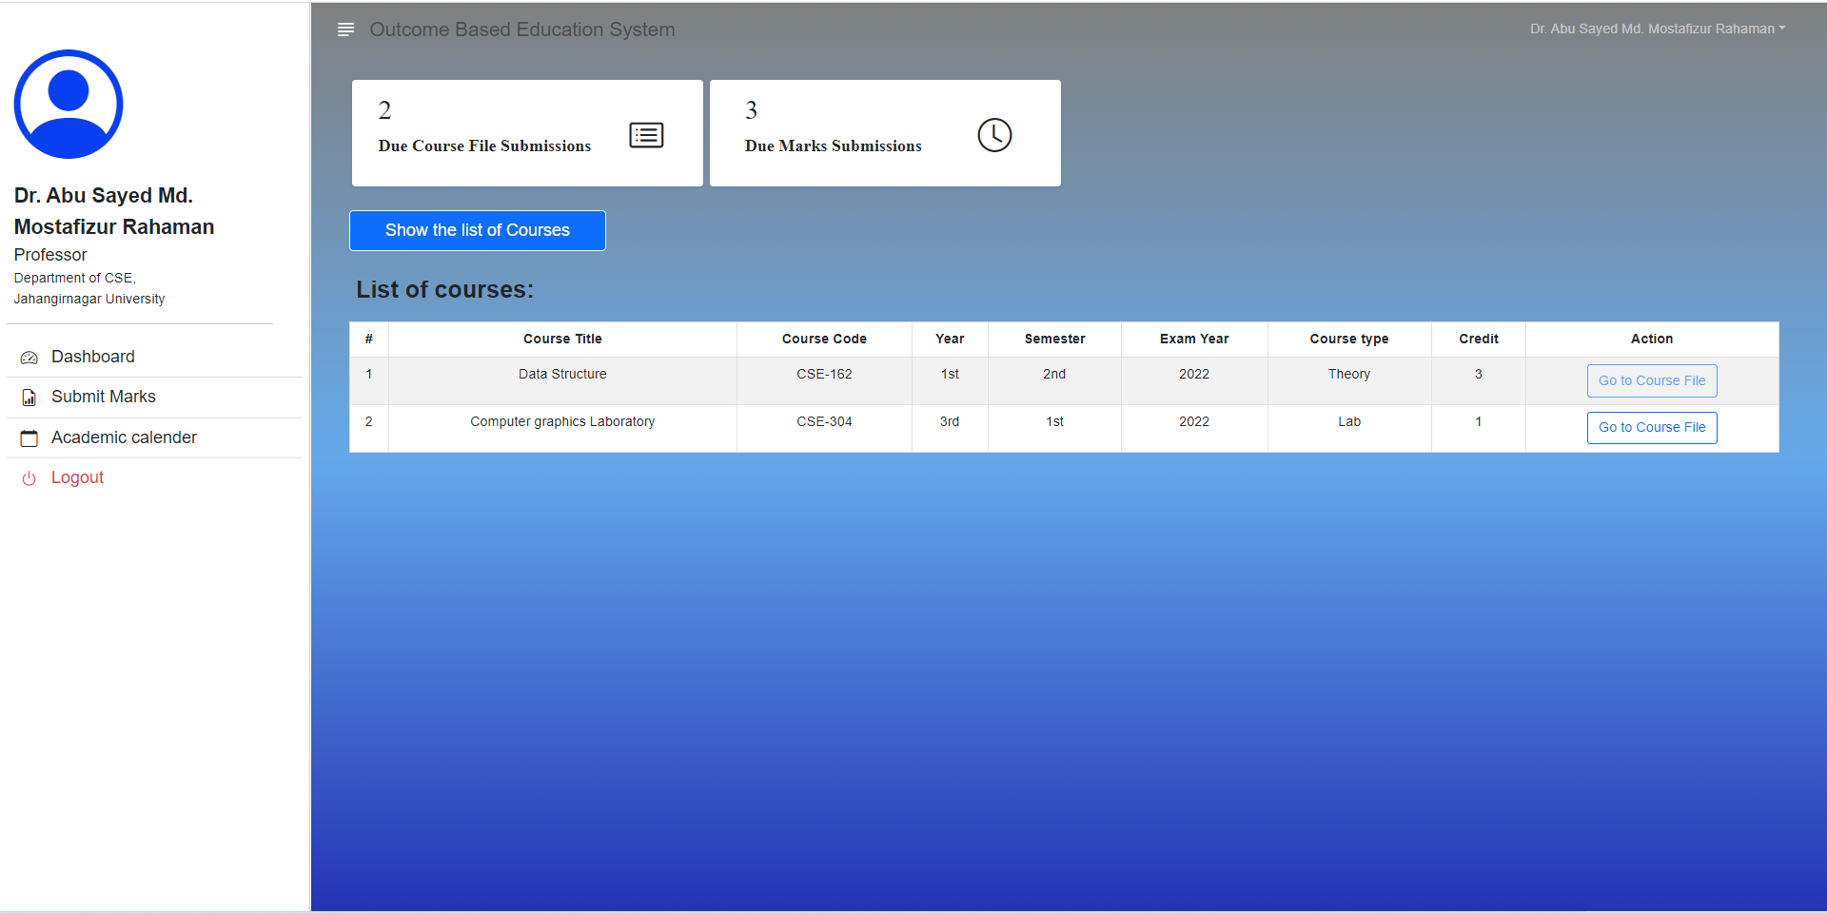
Teacher Dashboard

Slide 12
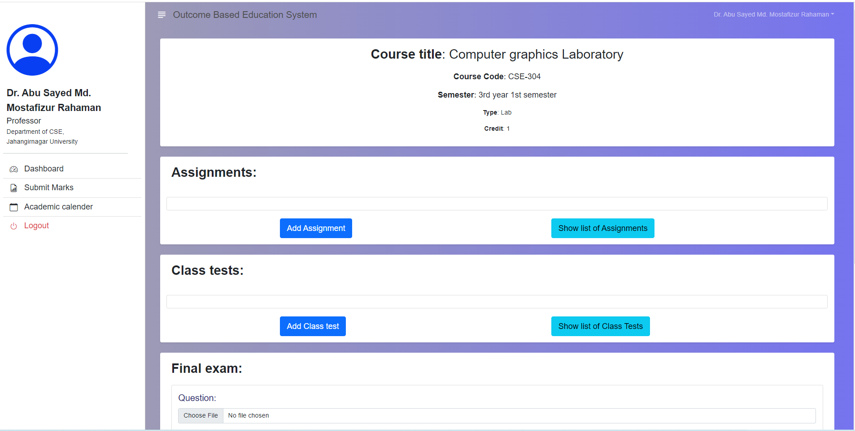
Manage Course File

Slide 13
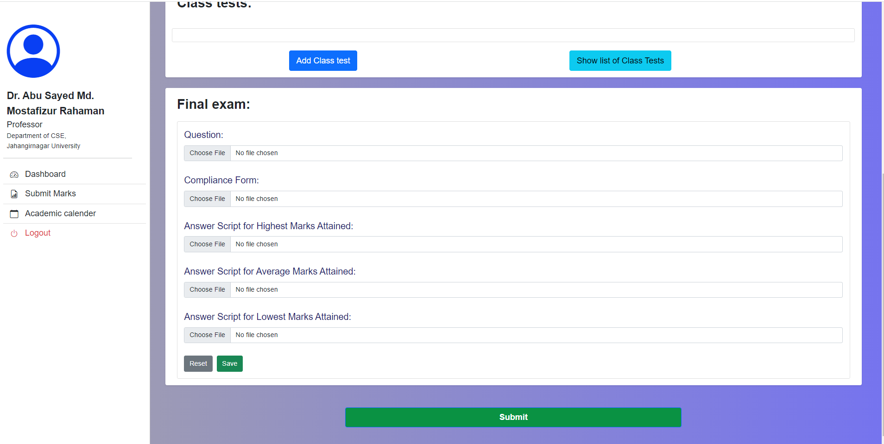
Manage Course File Cont….

Slide 14
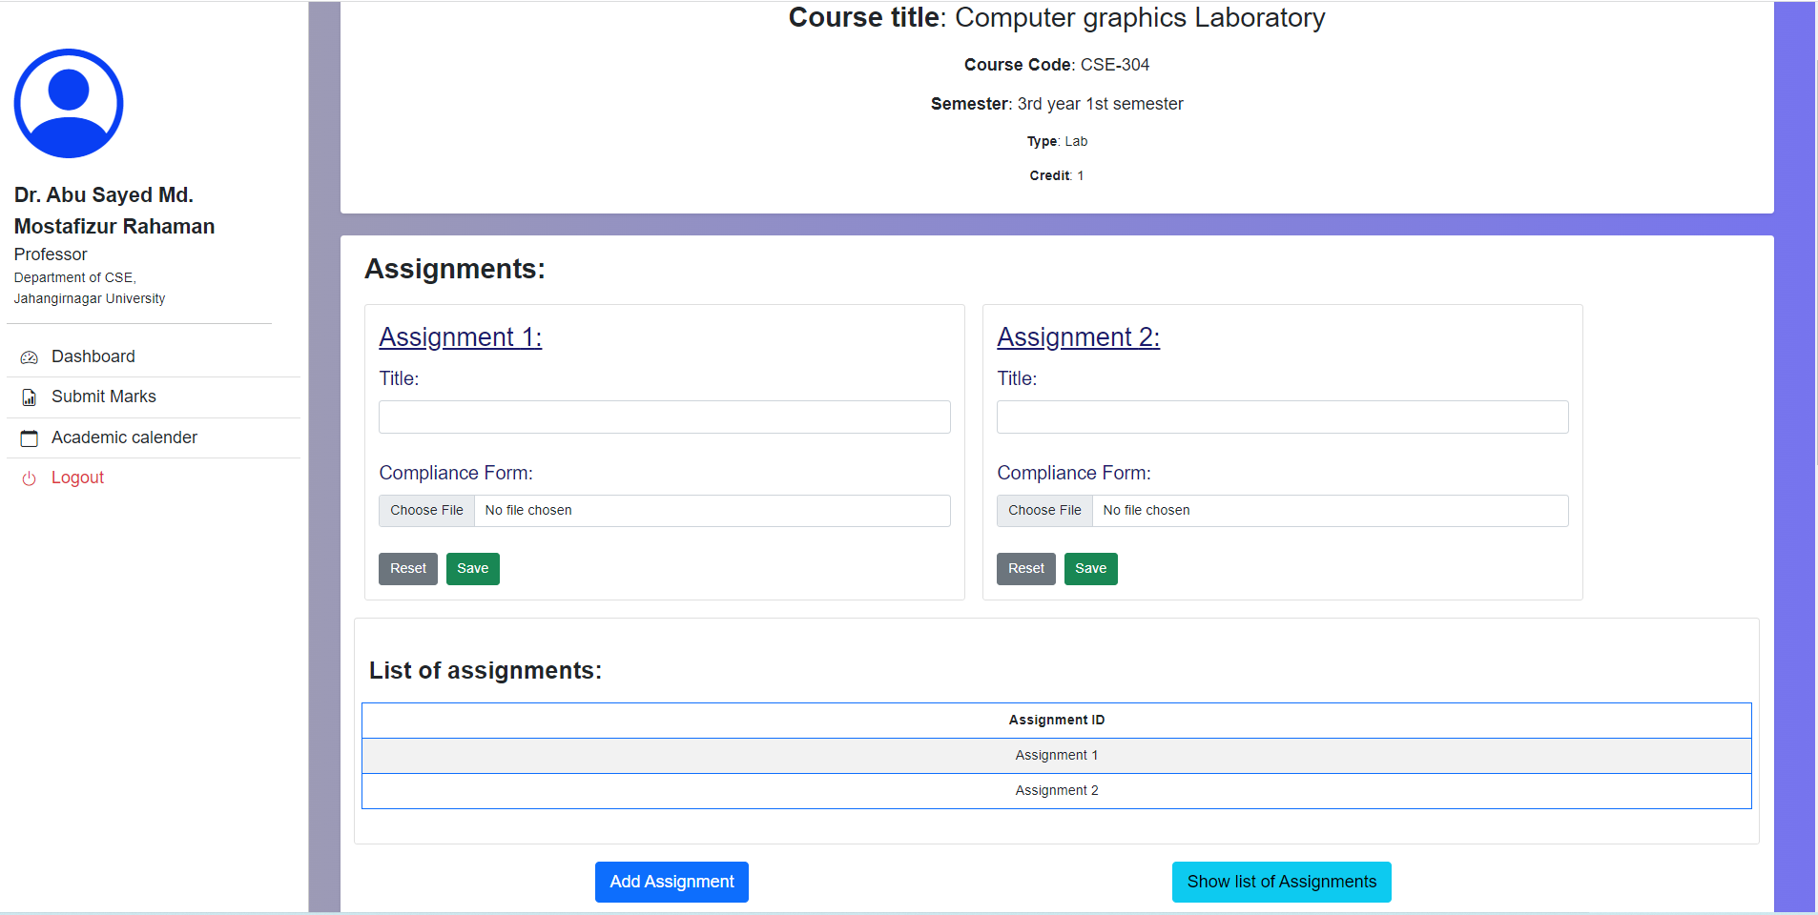
Manage Course File Cont…..

Slide 15
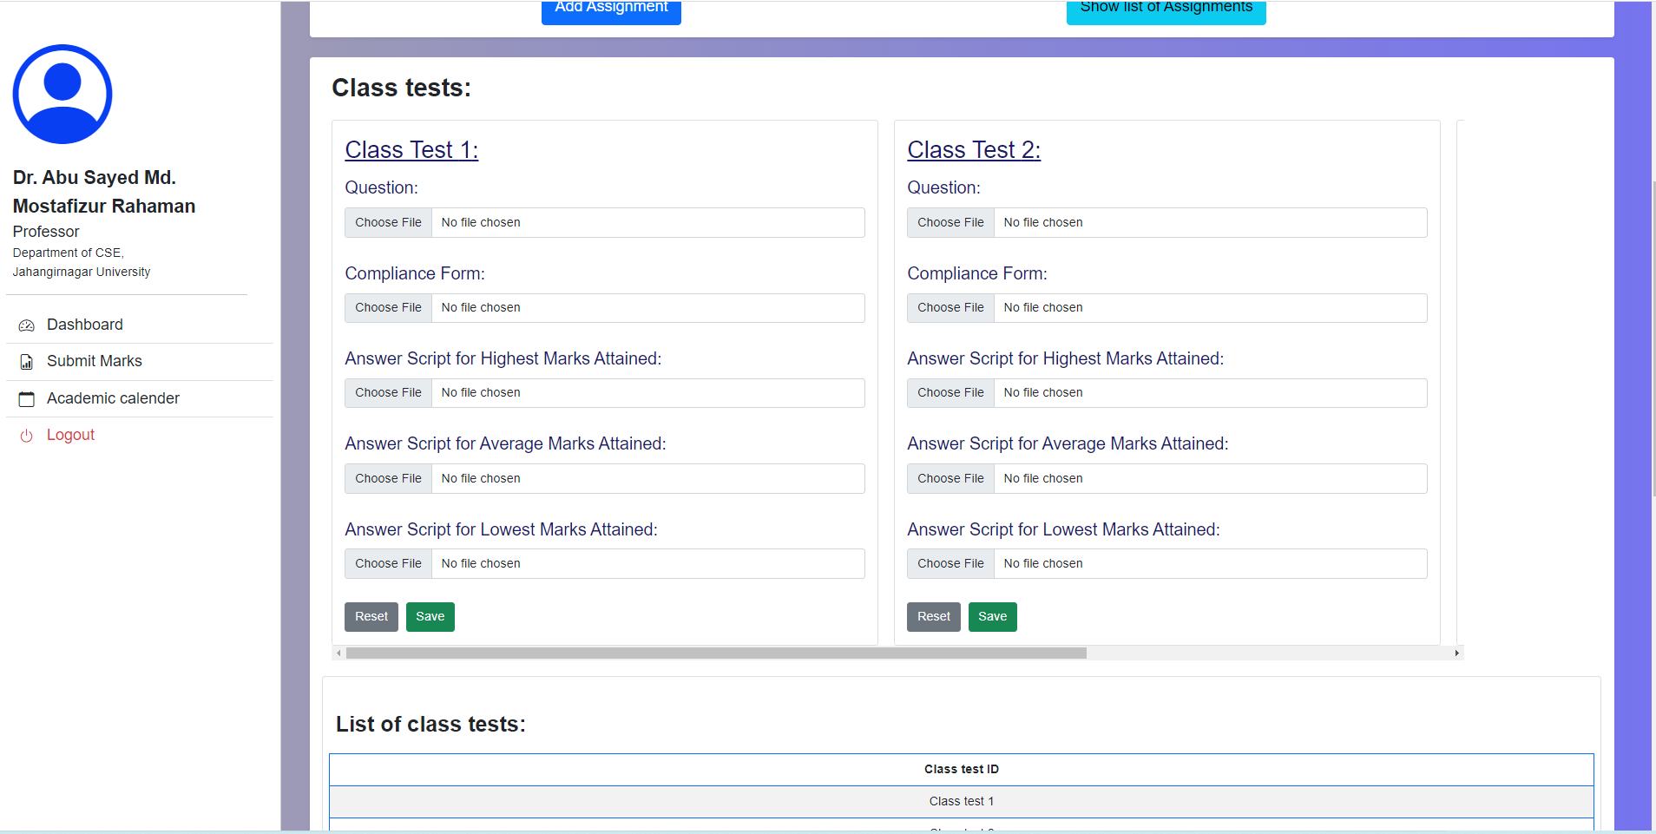
Manage Course File Cont…..

Slide 16
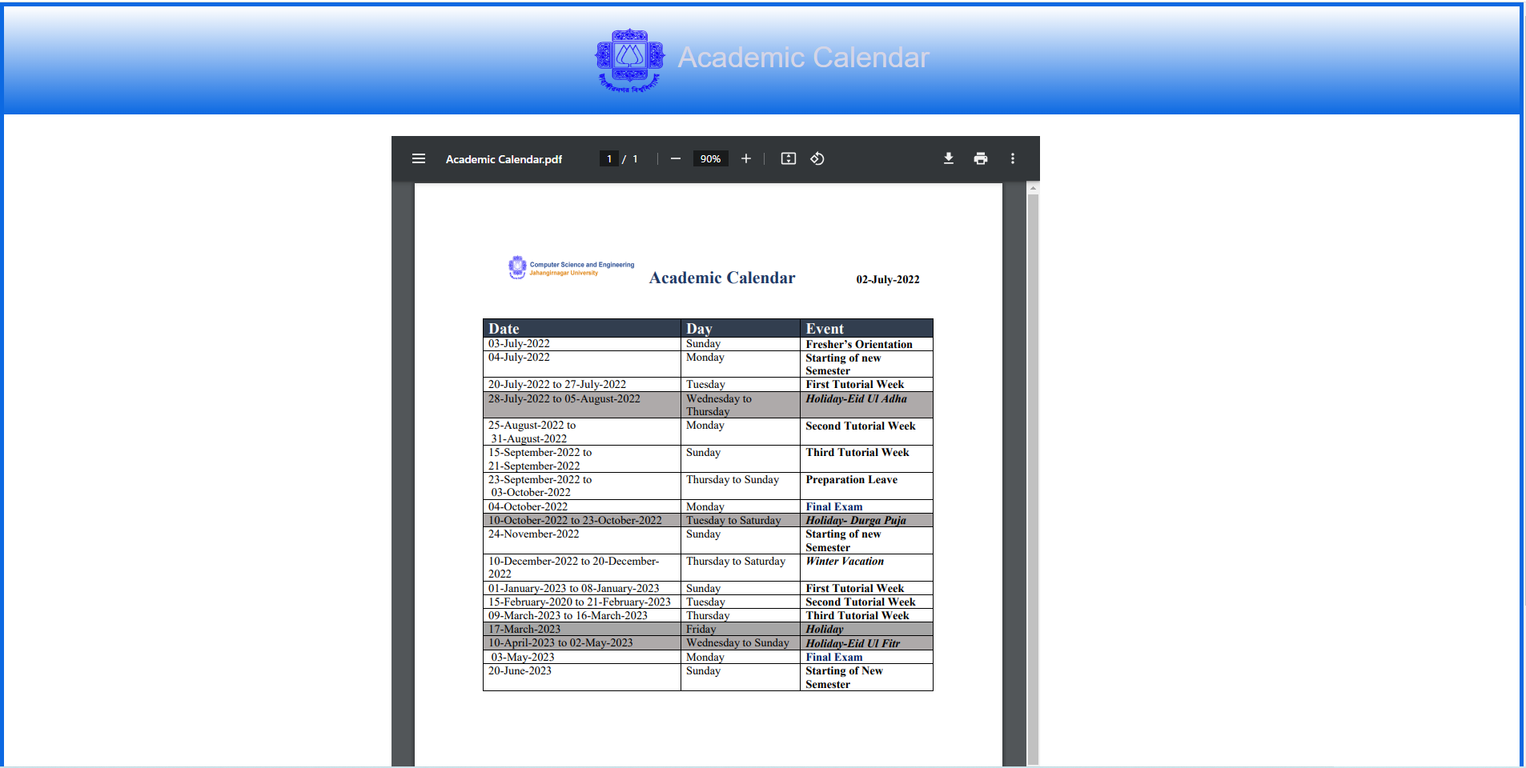
Academic Calendar

Slide 17
Department Admin Part

Slide 18
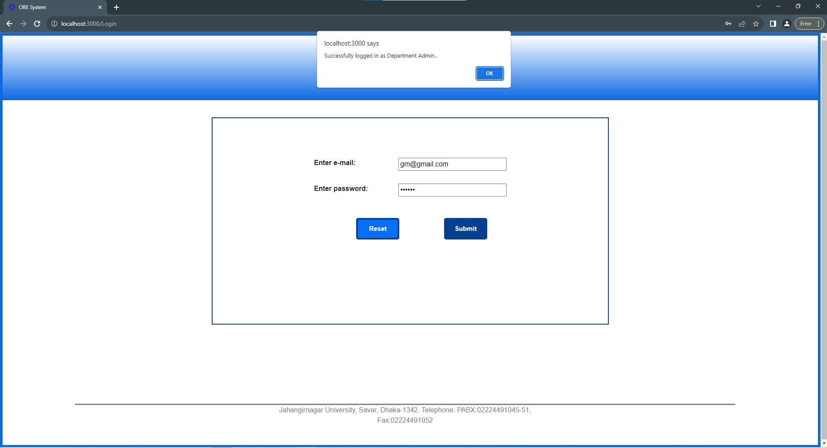
Log In As Department Admin

Slide 19
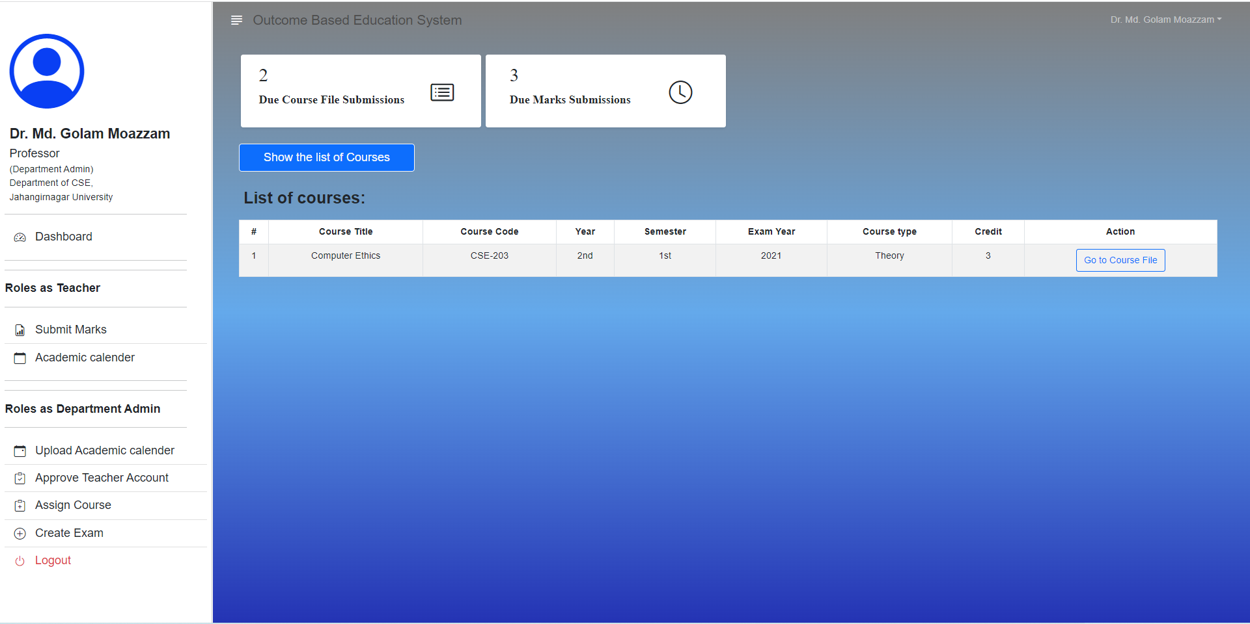
Department Admin Dashboard

Slide 20
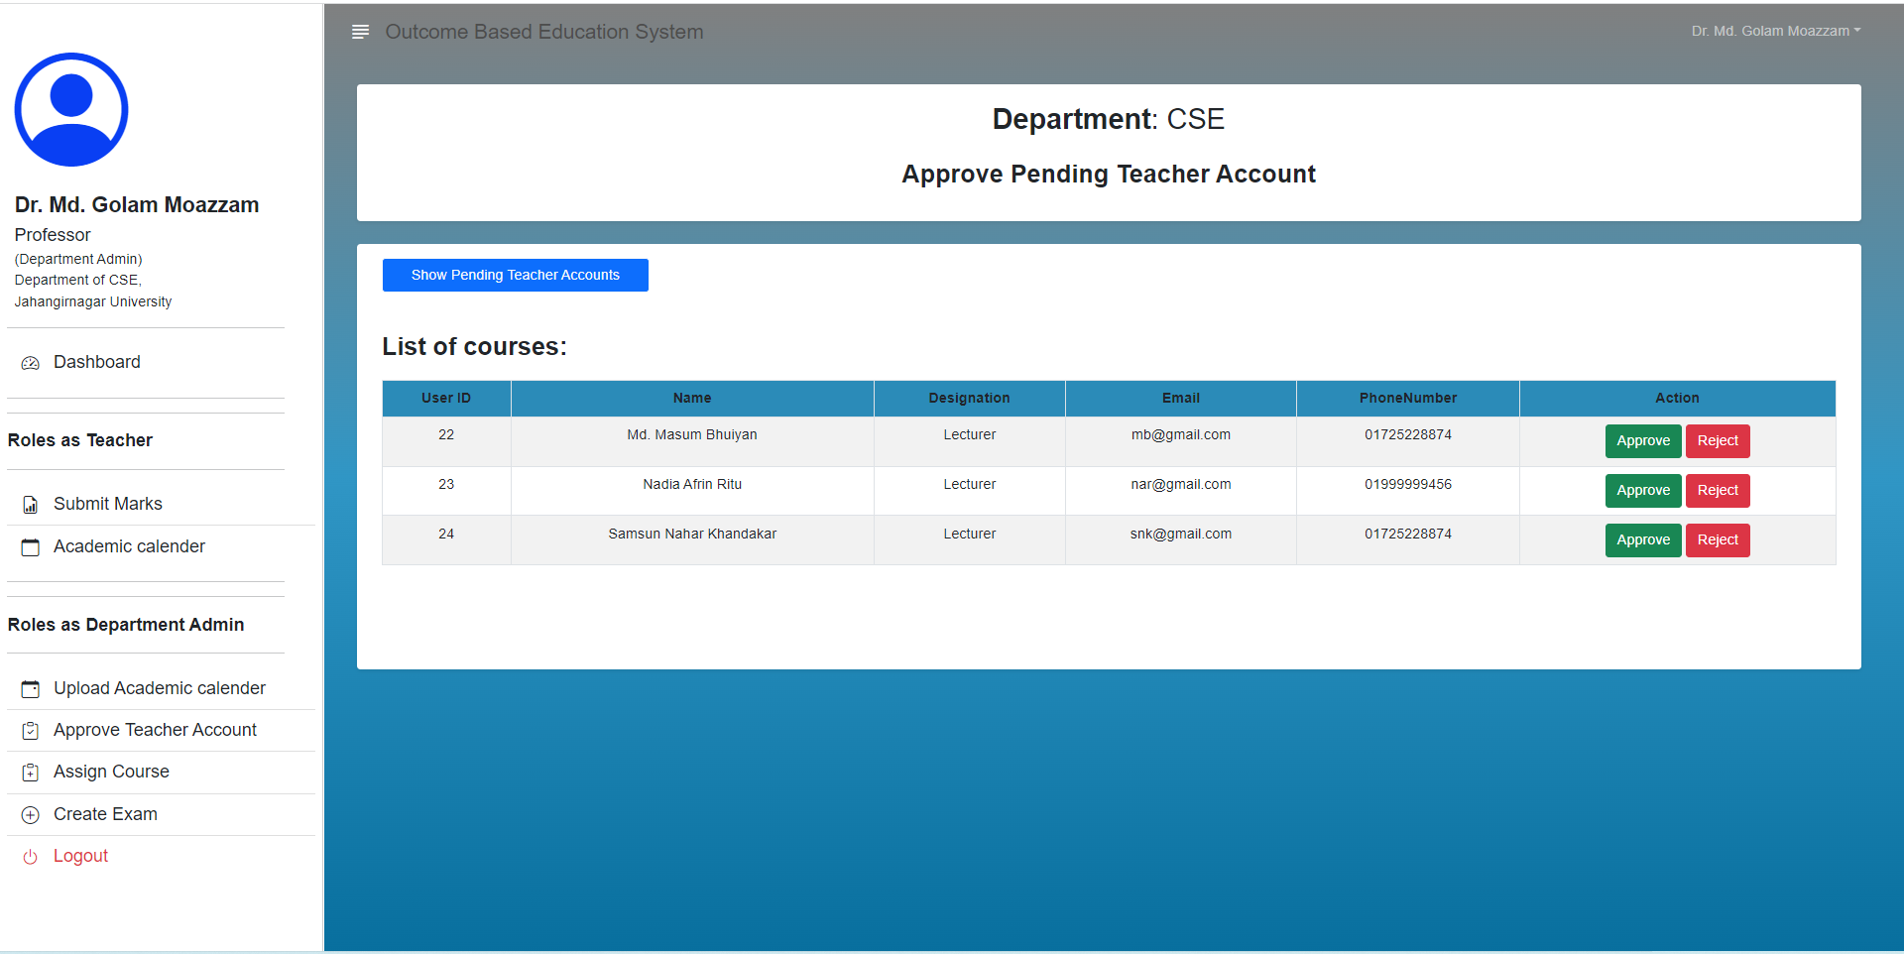
Approve Pending Teacher Accounts

Slide 21
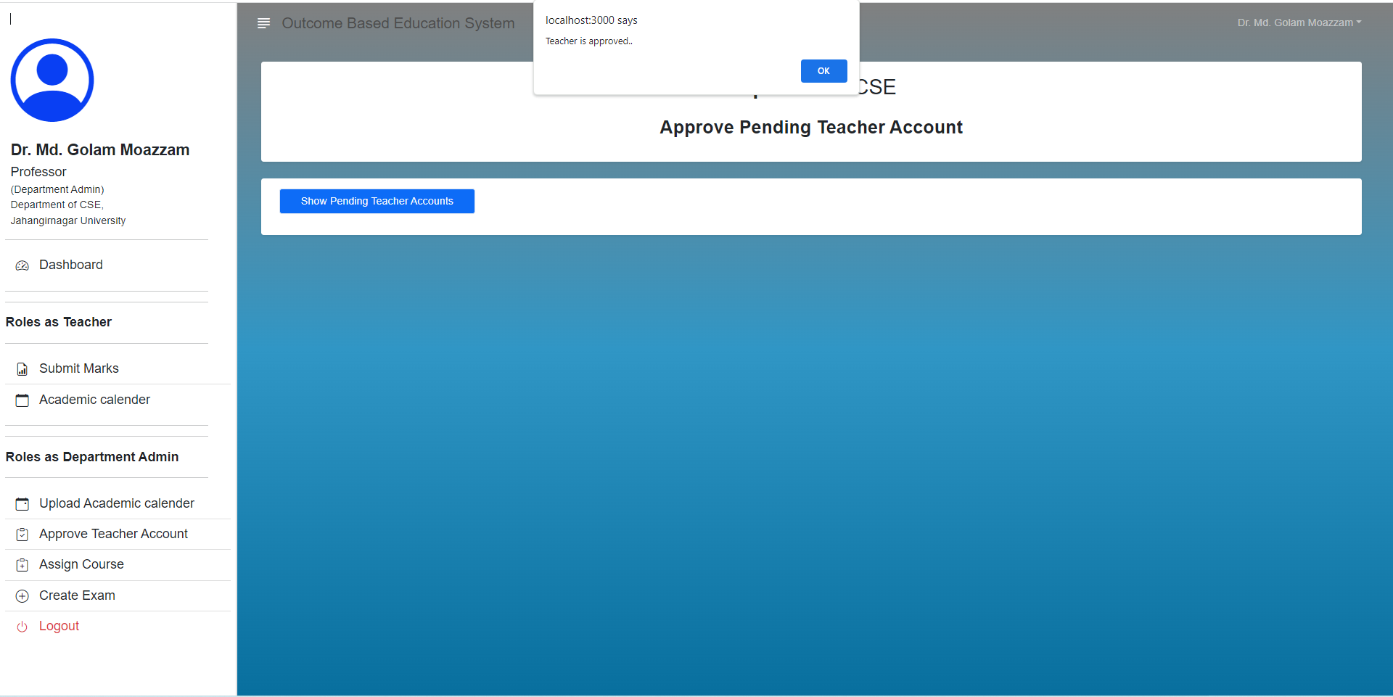
Approve Pending Teacher Accounts

Slide 22
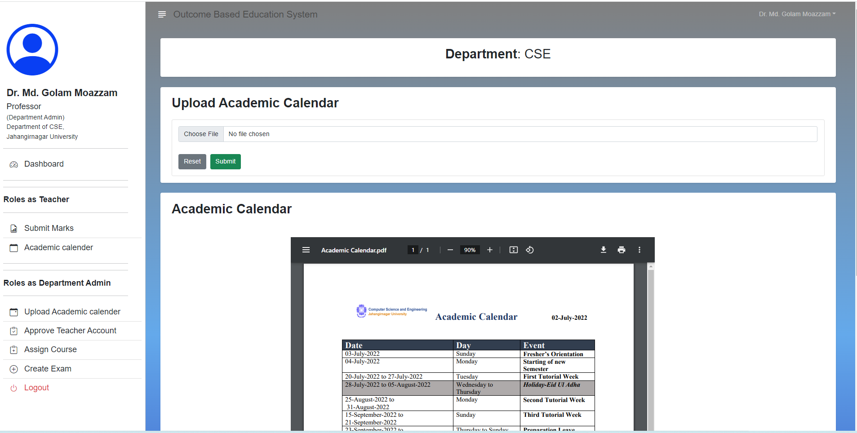
Upload Academic Calendar

Slide 23
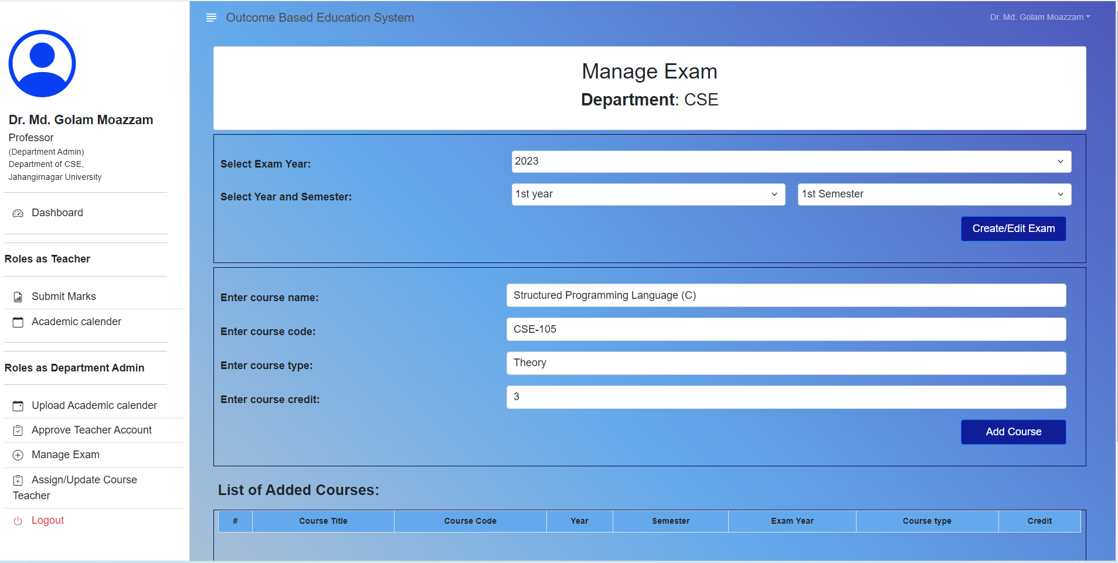
Manage Exam

Slide 24
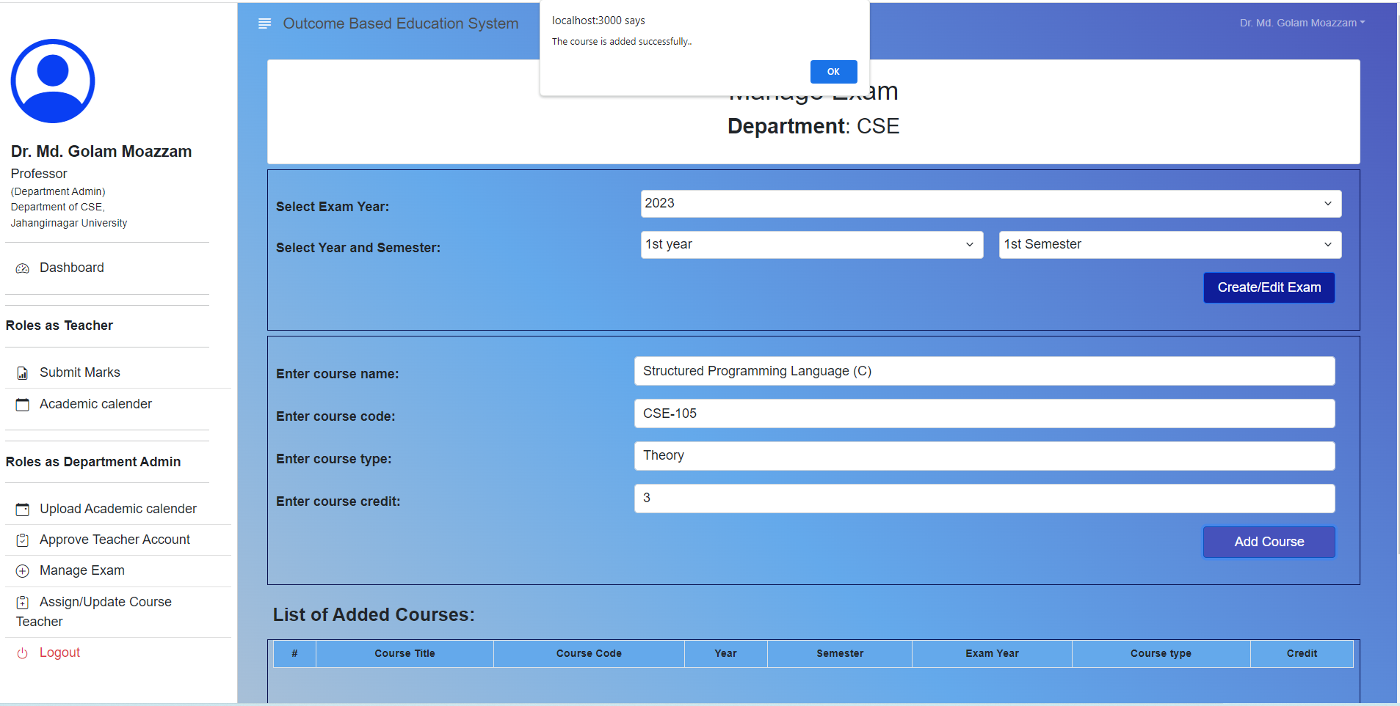
Add Course

Slide 25
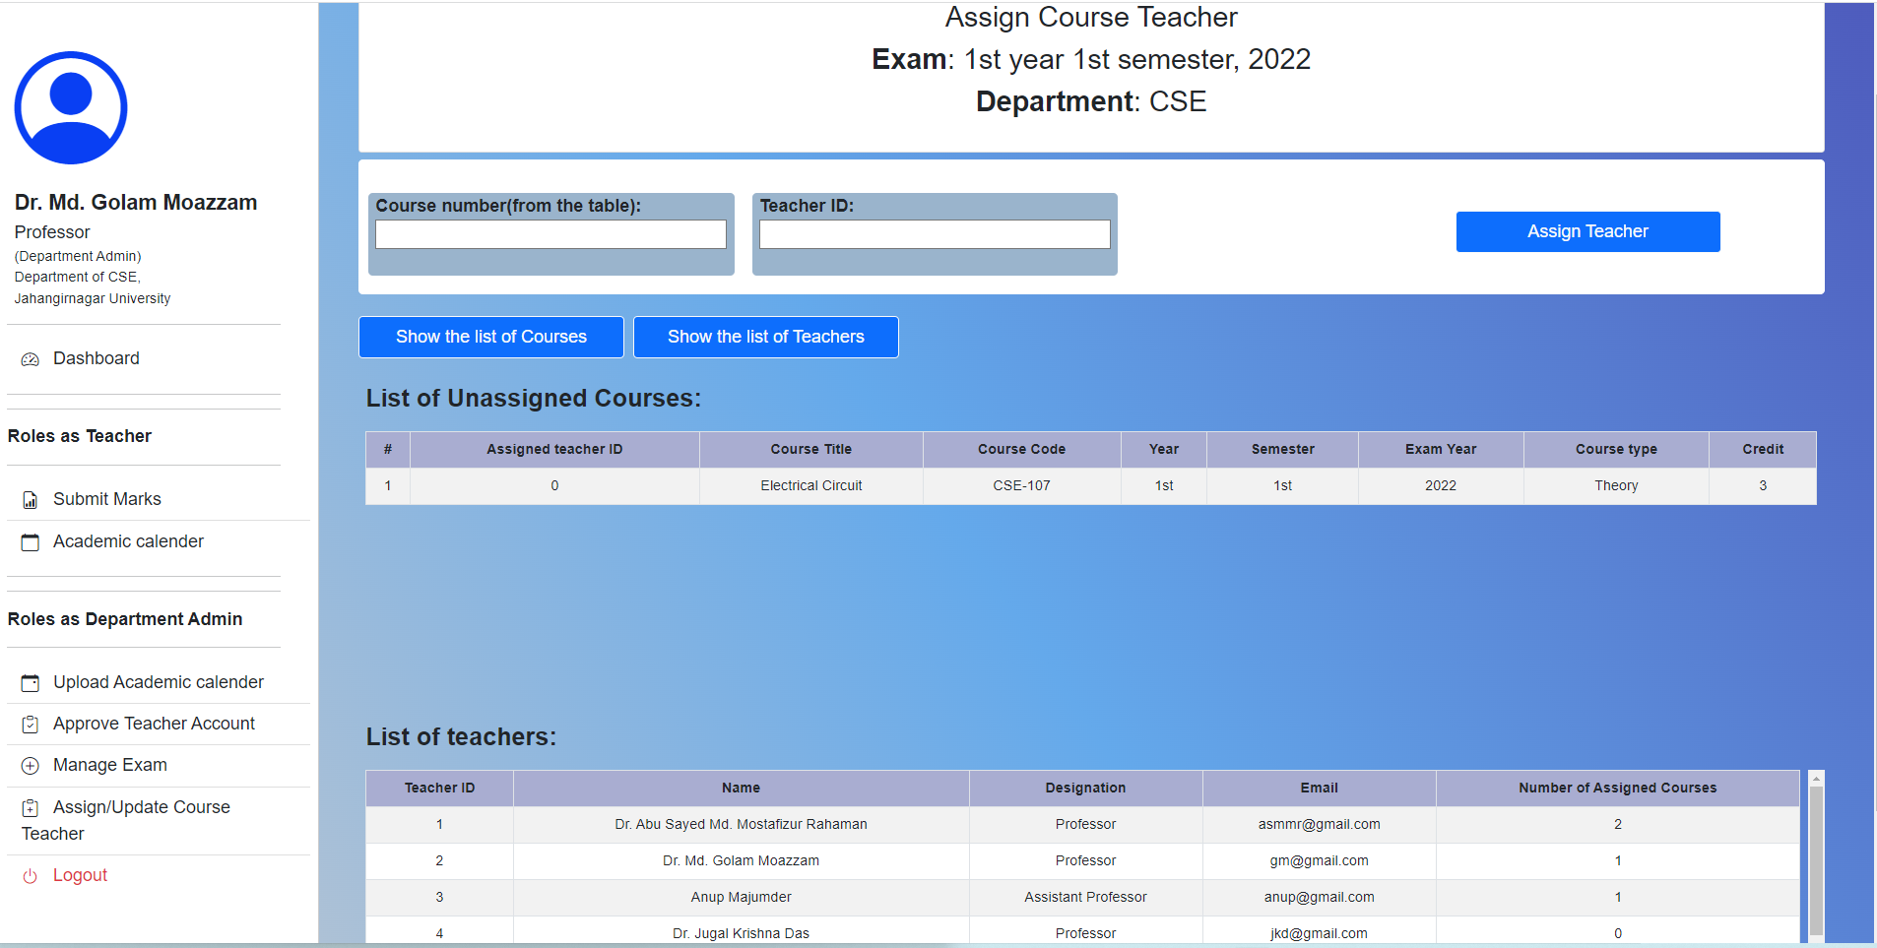
Assign Course Teacher

Slide 26
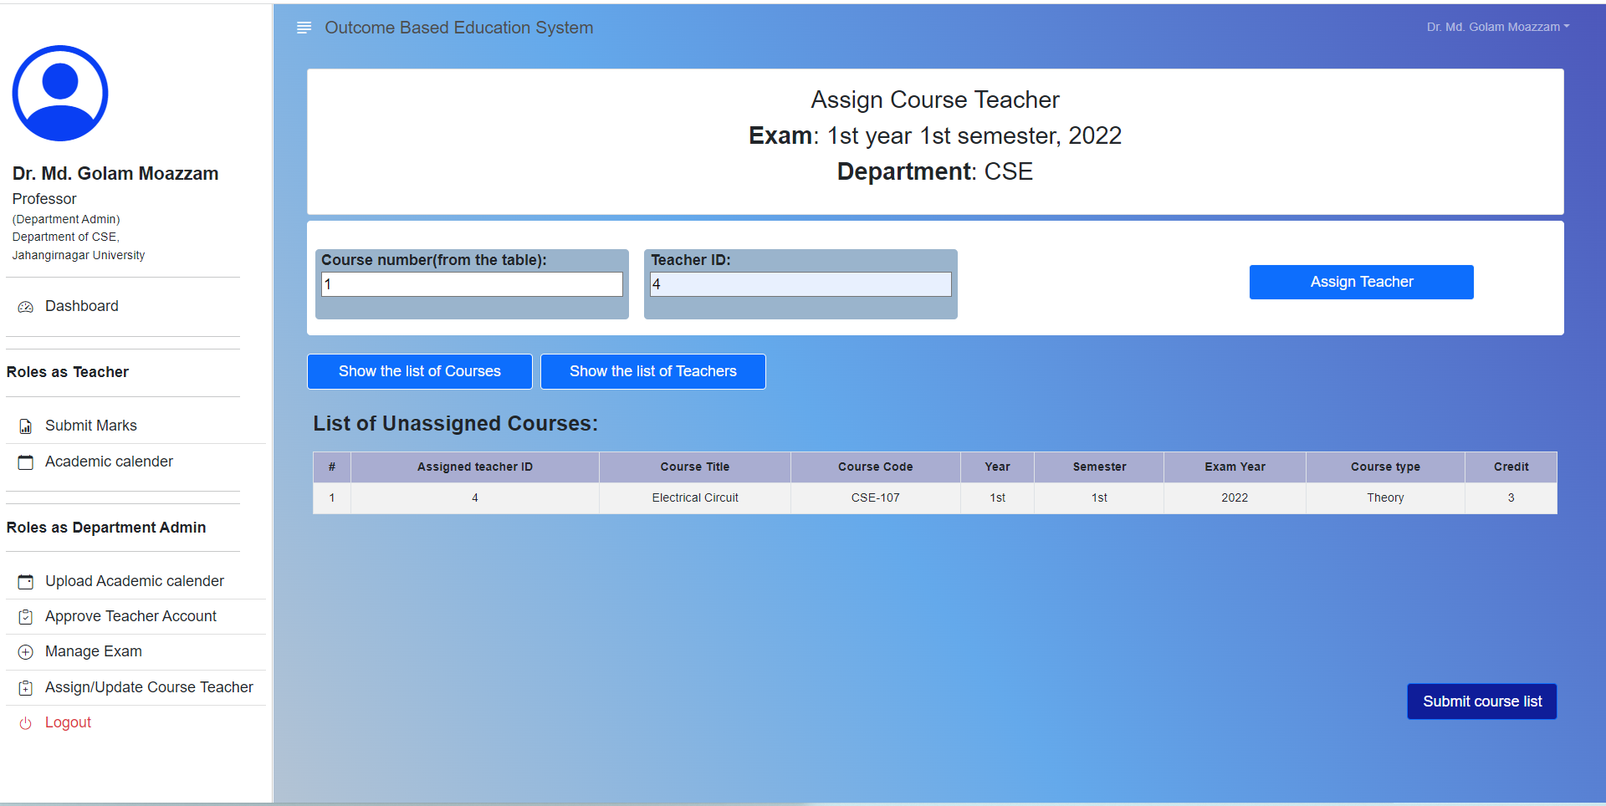
Assign Course Teacher (cont…)

Slide 27
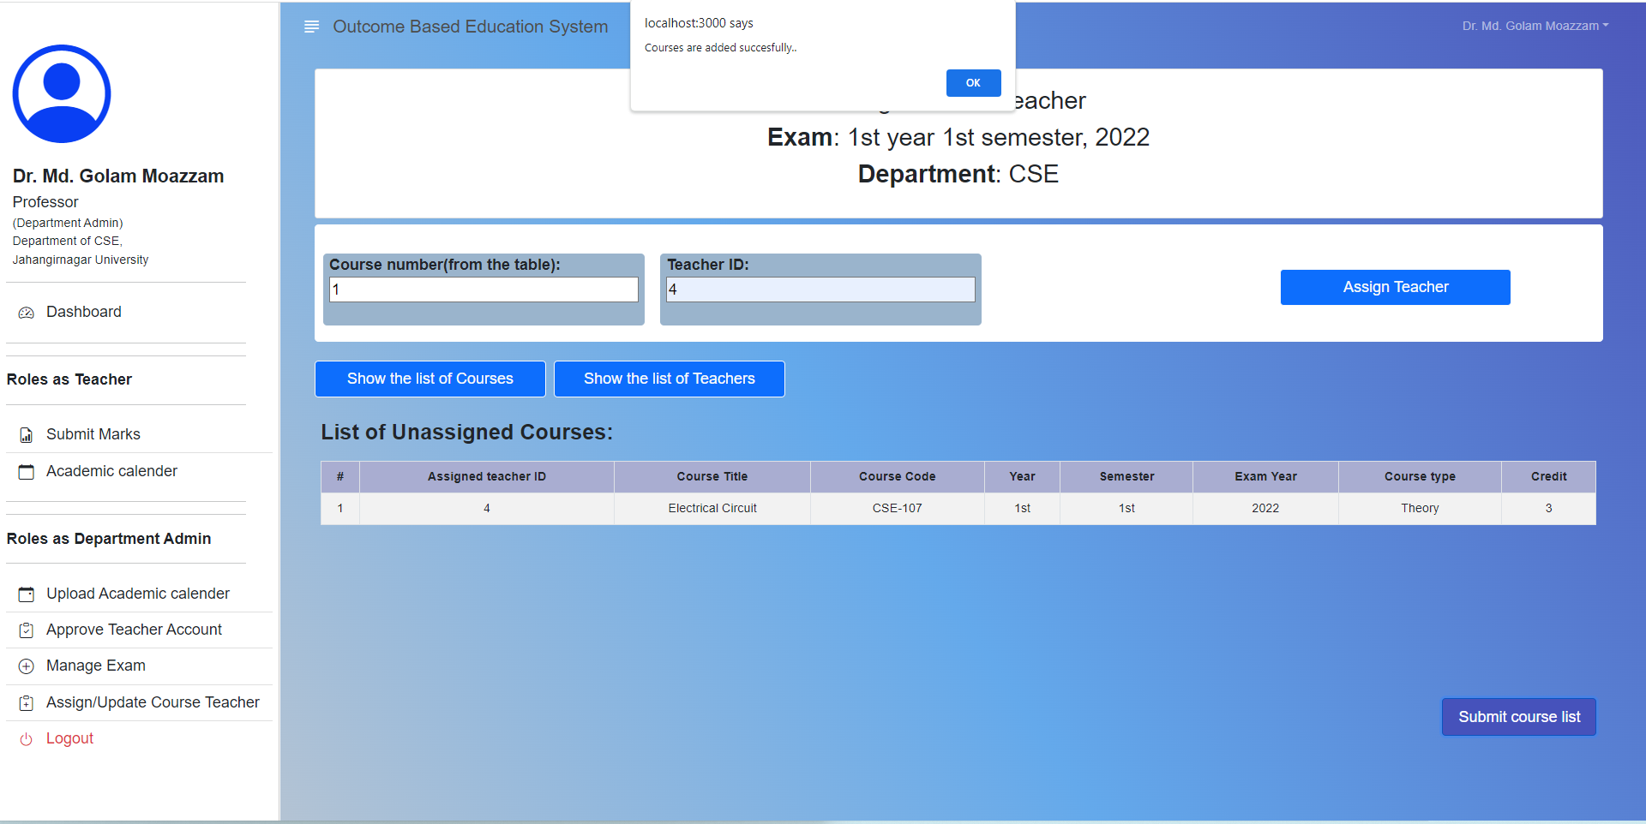
Assign Course Teacher Done

Slide 28
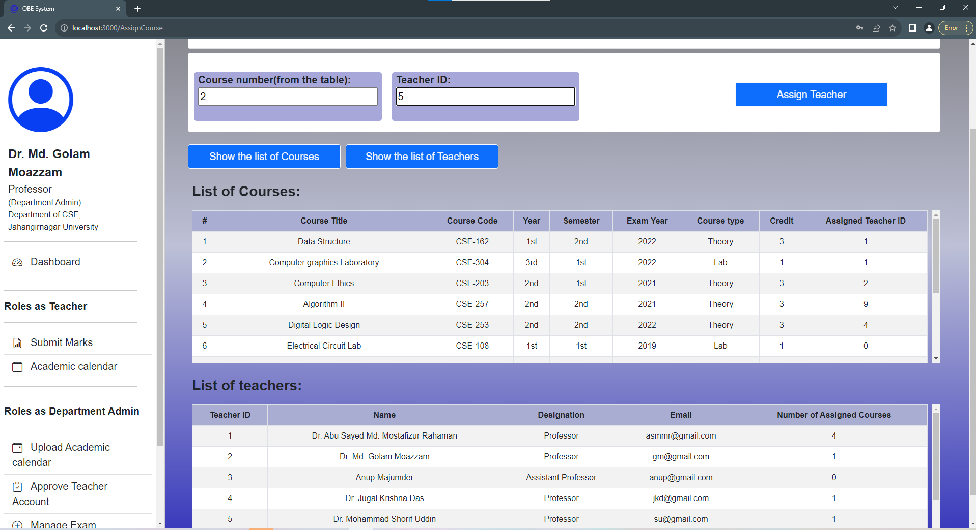
Update of Course Teacher of the selected course

Slide 29
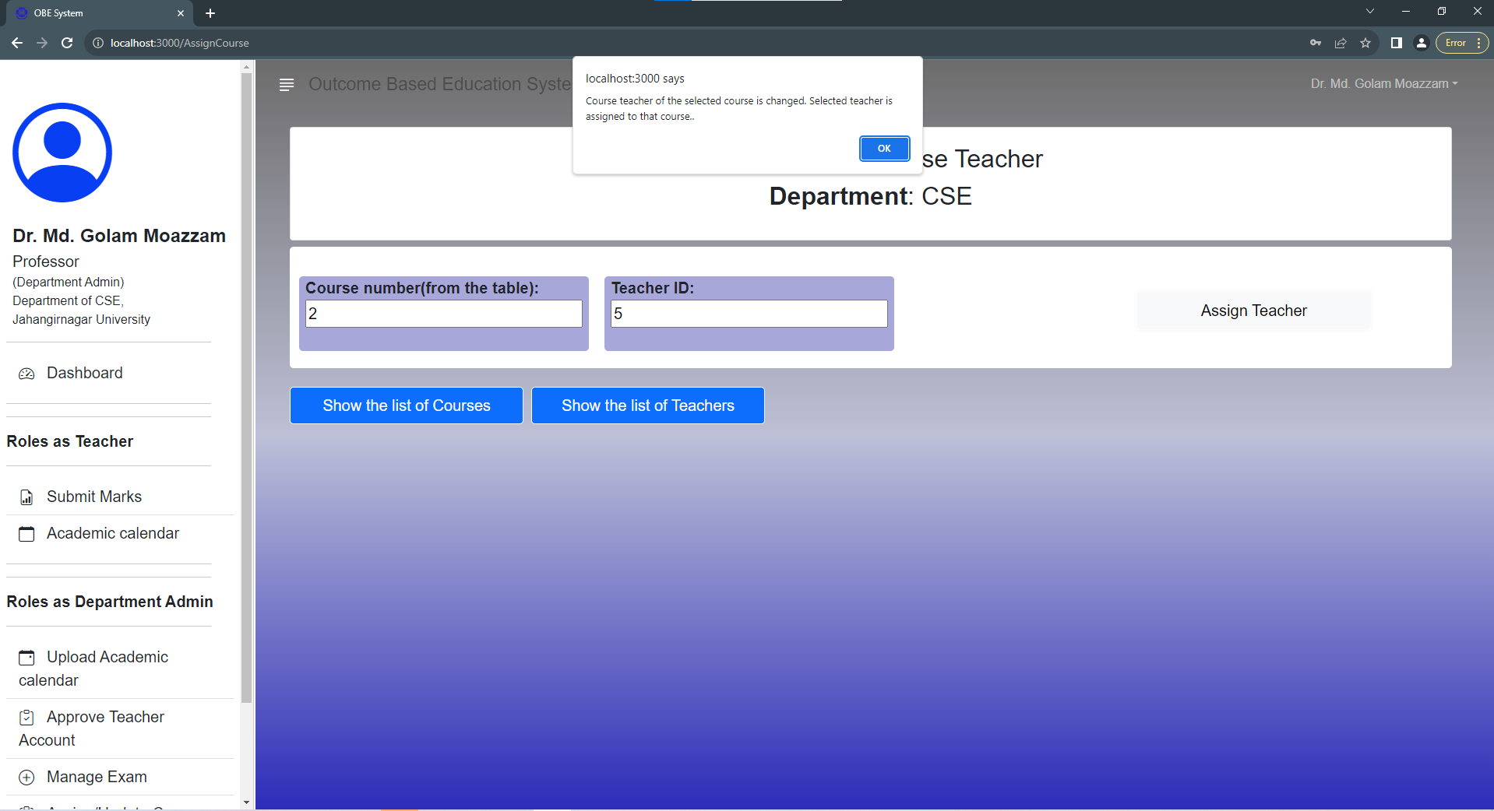
Update of Course Teacher of the selected course(cont.)

Slide 30
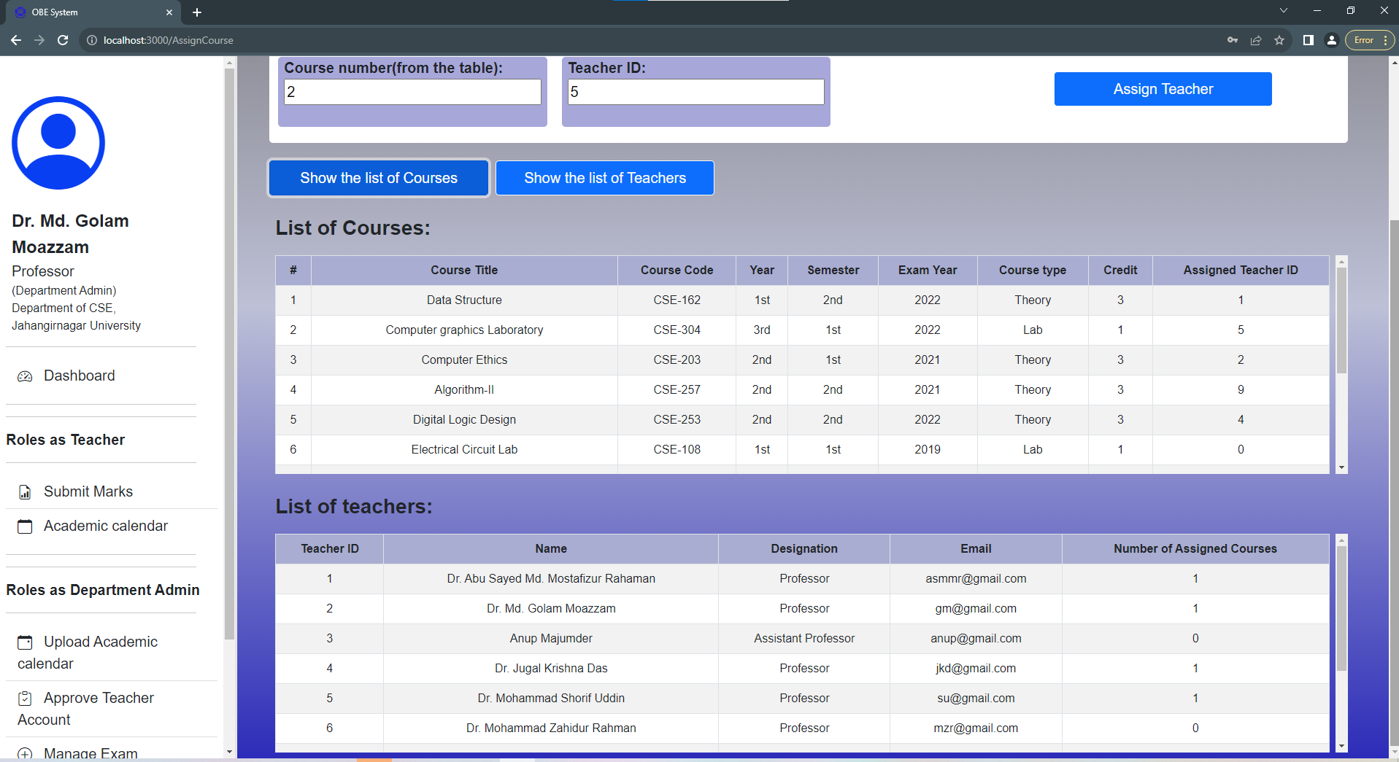
Saved updated Course Teacher information

Slide 31
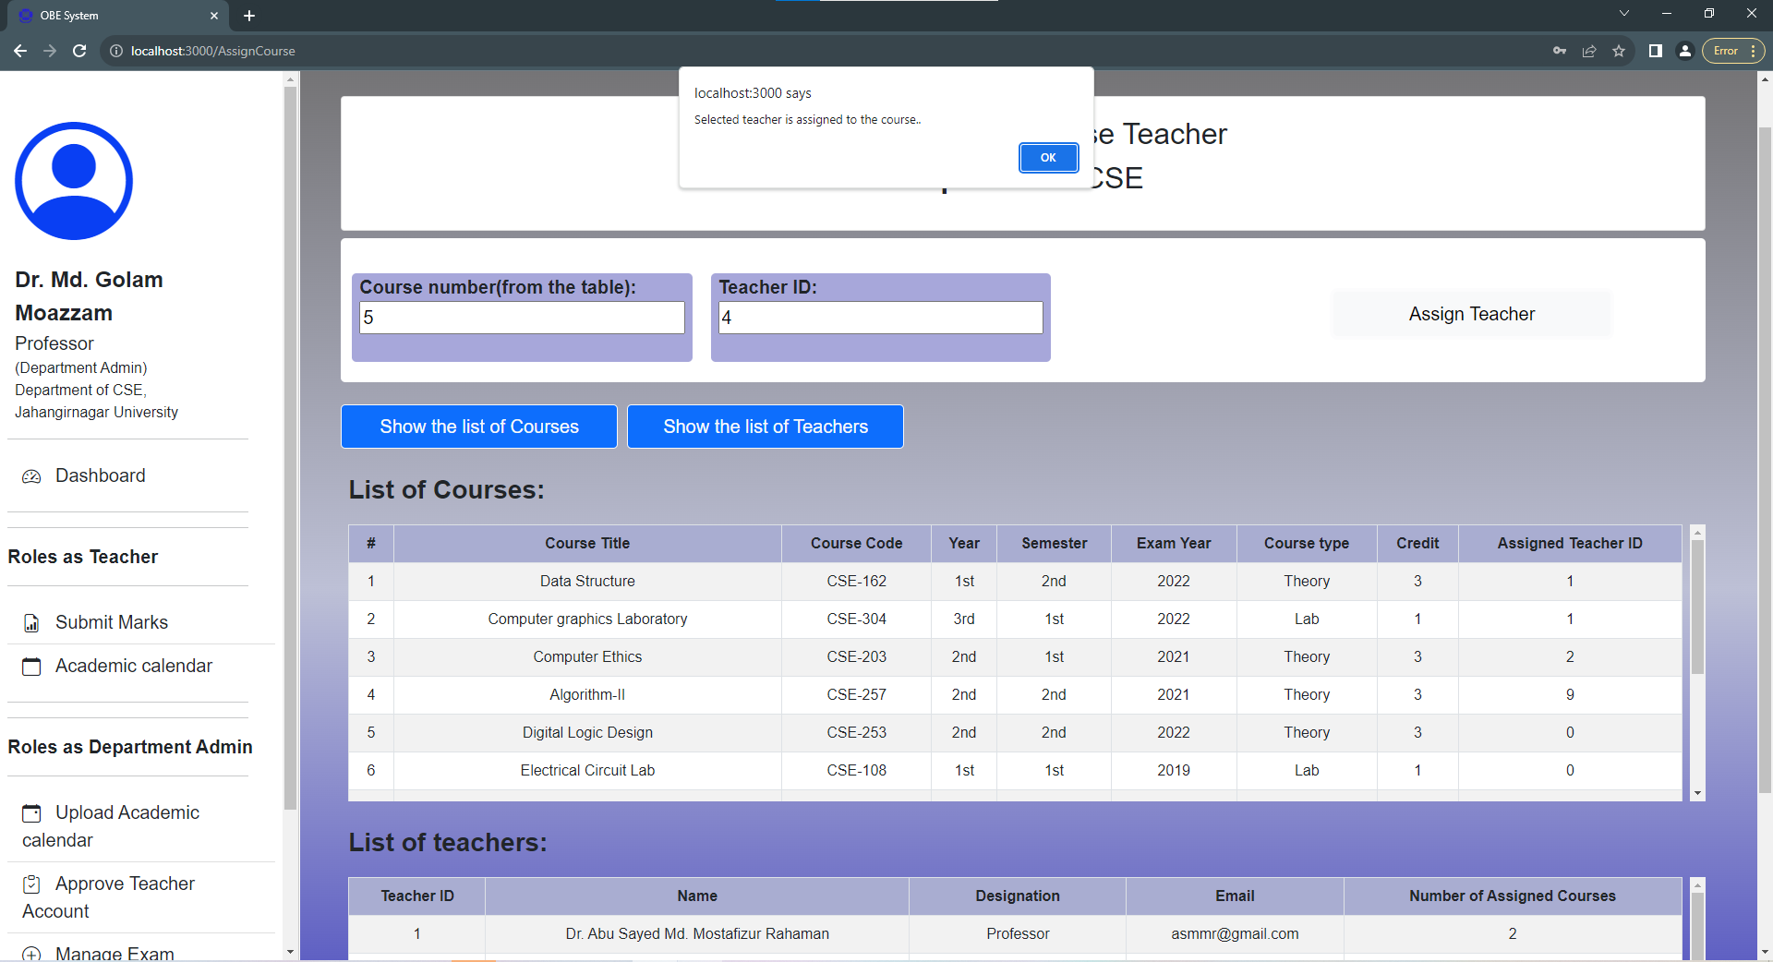
Assign Course Teacher after creating exam

Slide 32
Exam Control Office Part

Slide 33
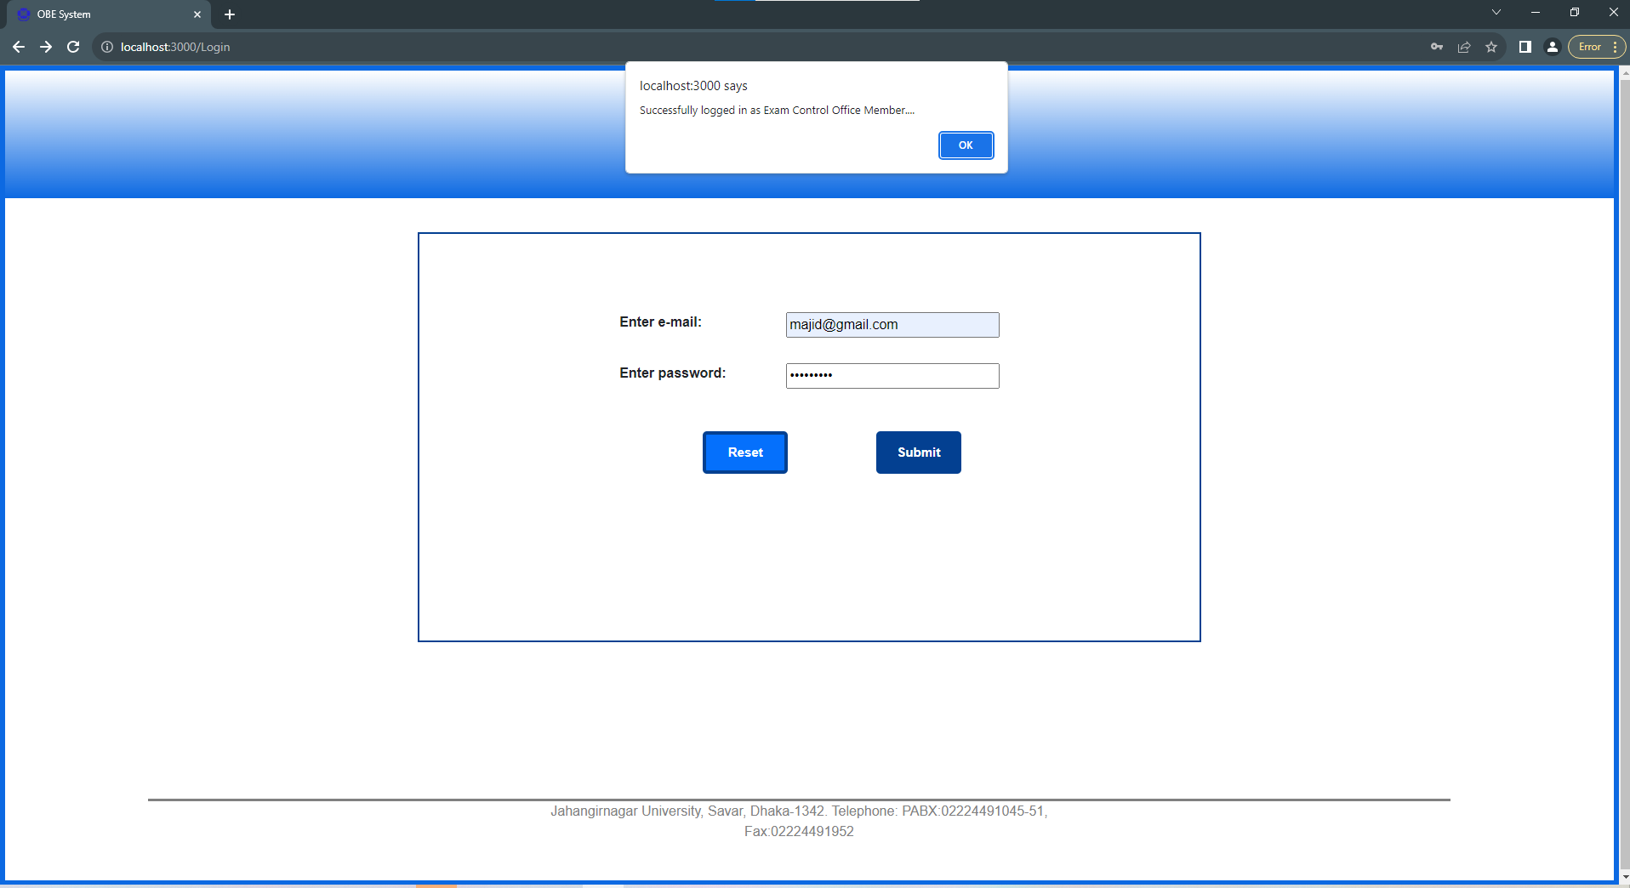
Logged in as Exam Control Office employee

Slide 34
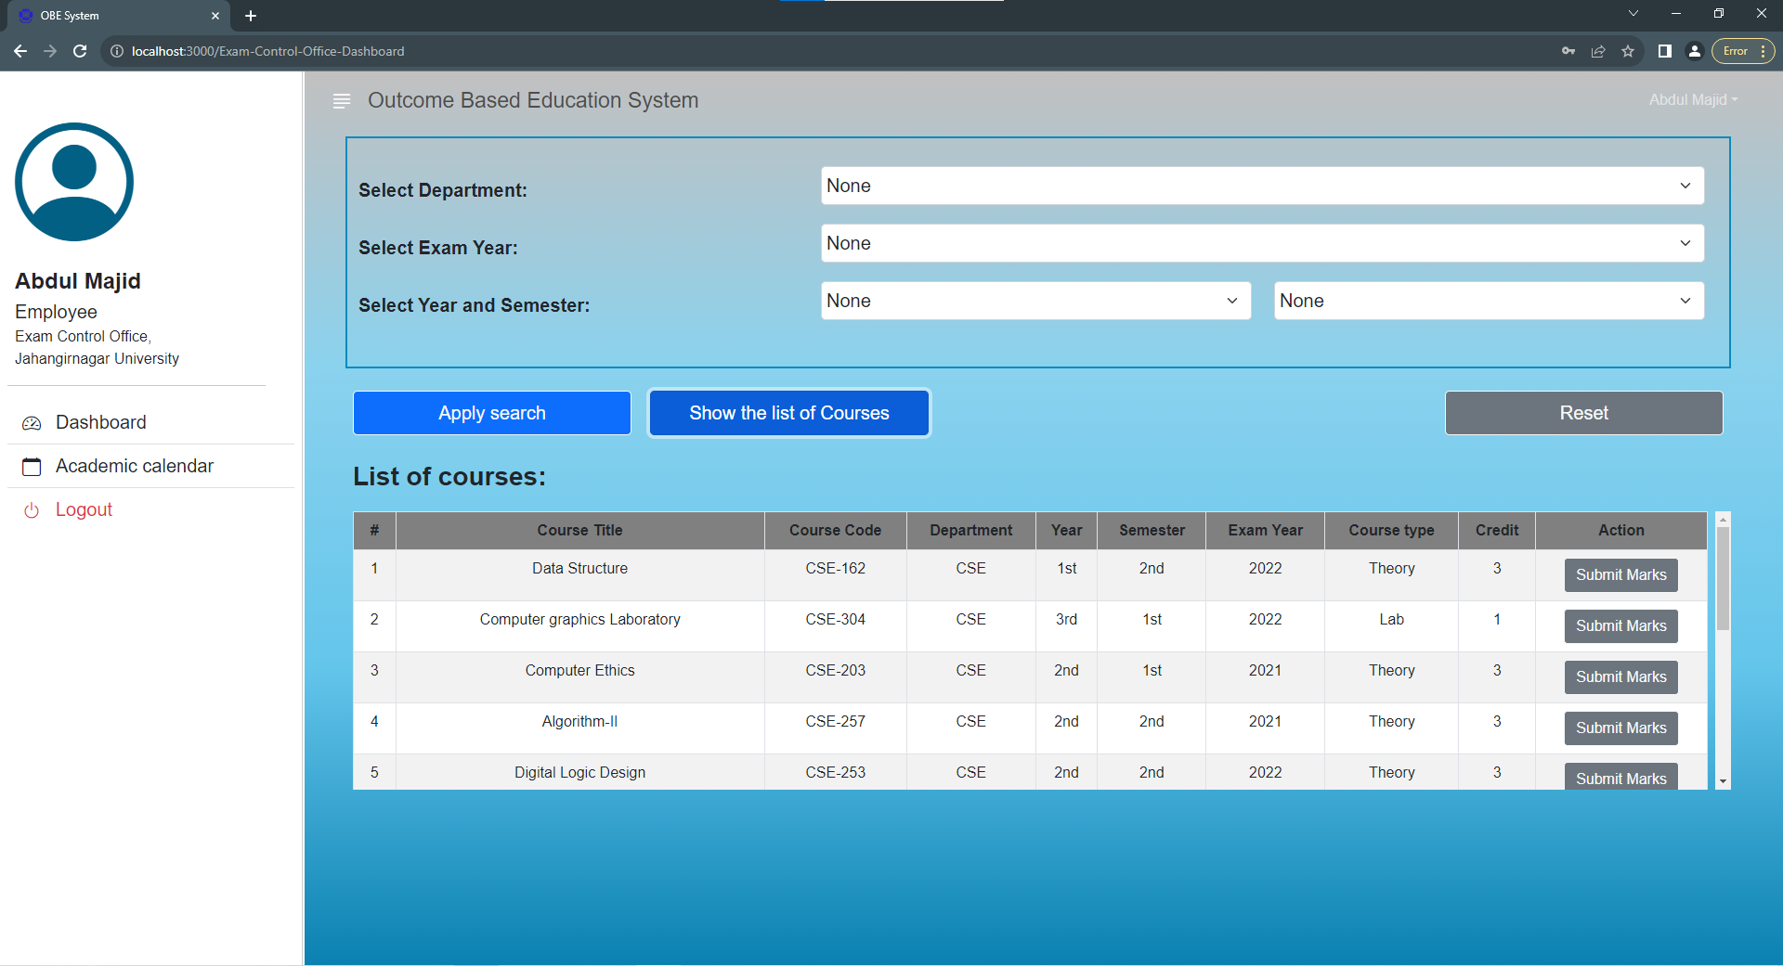
Exam Control Office Dashboard

Slide 35
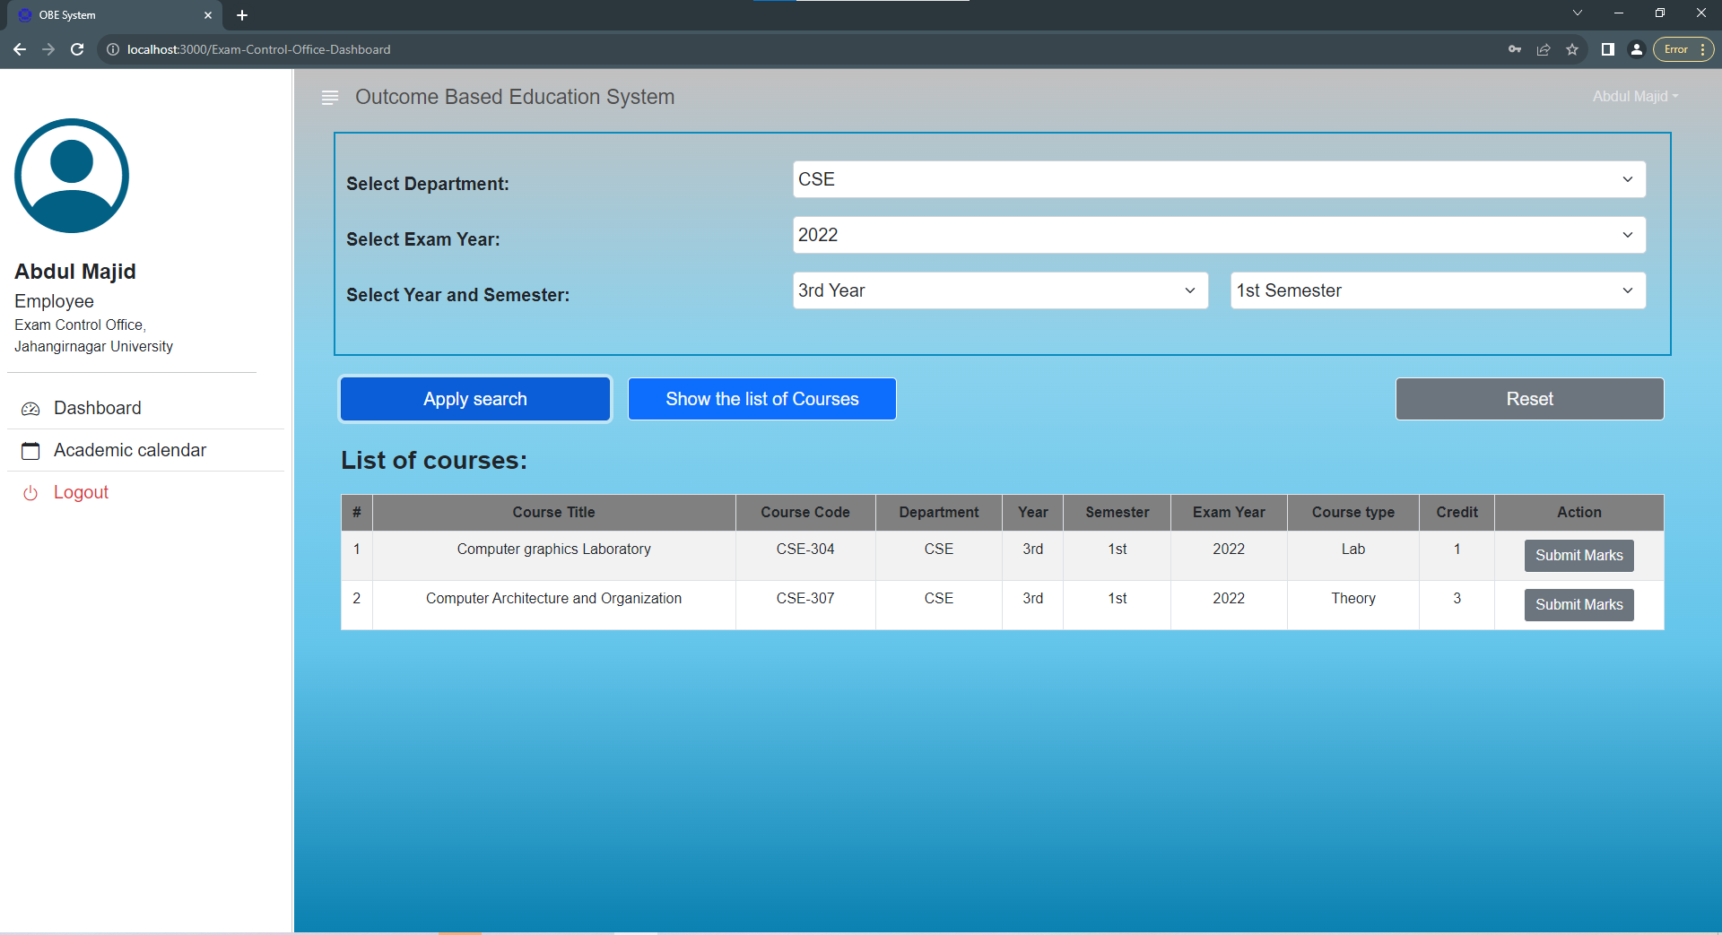
User Interface For Searching Particular Courses

Slide 36
Thank You

